Slide 1
Abnormal Psychology
Ms. Rabia Ijaz
Lecturer (Psychology)
Science and Humanities

Slide 2
Learning Outcomes
Distinguish between normal and abnormal behaviors
Learn about mental disorders
Learn about various treatment approaches for psychological disorders

Slide 3
Mental Health
According to World Health Organization (WHO):
“Mental Health is a state of well-being in which an individual realizes his or her
own abilities, can cope with the normal
stresses of life, can work productively,
and is able to make a contribution to his or her community”

Slide 4
Abnormal Psychology
“Branch of psychology
deals with the abnormal /
pathological mental processes and behaviors”

Slide 5
Normal and Abnormal Behaviors
How can we distinguish normal from abnormal behavior?

Slide 6
Identifying Abnormality 4-Ds
Deviation from Social Norms
Abnormality as a Sense of Personal Discomfort (Distress)
Highly unusual behaviors that stray far from the norms.
Example: Hearing voices
Behavior is considered abnormal if it produces a sense of personal distress, anxiety, or guilt in an individual—or if it is harmful to others in some way.
Example: Obsessive Compulsive Disorder

Slide 7
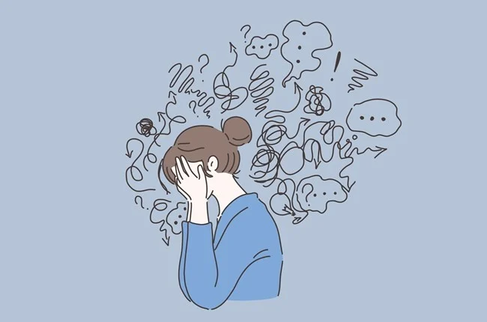

Abnormality as a Dysfunction
Abnormality as Danger
Disability or an impairment in some important areas of life (work or in personal relationship).
Example: Impact of Substance Use Disorders
Behaviors and feelings that cause interference with life and pose risk of harm.
Example: Paranoid ideation

Slide 8
Factors contributing to mental disorders
Biological
Psychological
Social
Neurochemicals, neurotransmitters, hormones, brain, nervous system etc.
Social support, family relations, friends, interpersonal factors, love, affiliation etc.
Cognitions, emotions, personality, coping styles, resilience, values, etc.

Slide 9
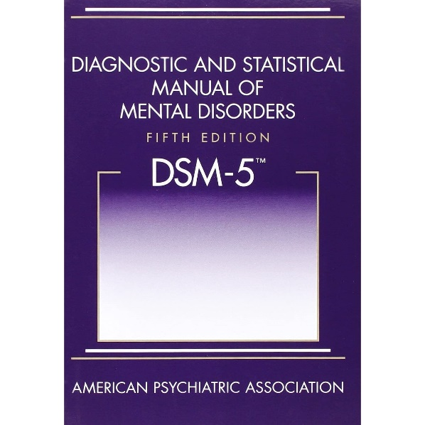
Diagnostic Statistical Manual of Mental Disorders
The big book of disorders.
DSM classifies disorders and describe the symptoms.
Does NOT explain the possible cures.
Published by the American Psychiatric Association

Slide 10
Two Major Classifications of Mental Disorders
Neurotic Disorders
Distressing but one can still function in society and act rationally.
Psychotic Disorders
Person loses contact with reality, experiences distorted perceptions.

Slide 11
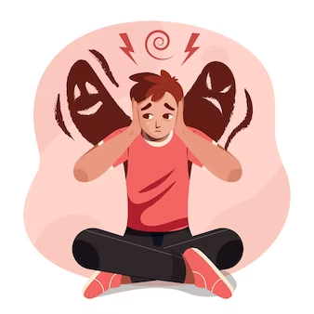
Neurotic Disorders
Generalized Anxiety Disorder
Depression
Obsessive-compulsive Disorder
Social Phobia
Posttraumatic Stress Disorder
Panic Disorder
Antisocial Personality Disorder
Psychotic Disorders
Schizophrenia
Brief Psychotic Disorder
Delusional Disorder
Substance-induced Psychotic Disorder

Slide 12

COMMON PSYCHOLOGICAL DISORDERS

Slide 13
Mental Disorders
According to DSM 5
“A mental disorder is a syndrome characterized by clinically significant disturbance in an individual's cognition, emotion, regulation or behavior that reflects a dysfunction in the psychological, biological, or developmental processes underlying mental functioning.
Mental disorders are usually associated with significant distress or disability in social, occupational or other important activities”

Slide 14
Mental Health Disorders
Depression
Schizophrenia
Post-traumatic Stress Disorder
Obsessive Compulsive Disorder
Bipolar
Caffeine Use Disorder
Internet Gaming Disorder
Panic Disorder

Slide 15
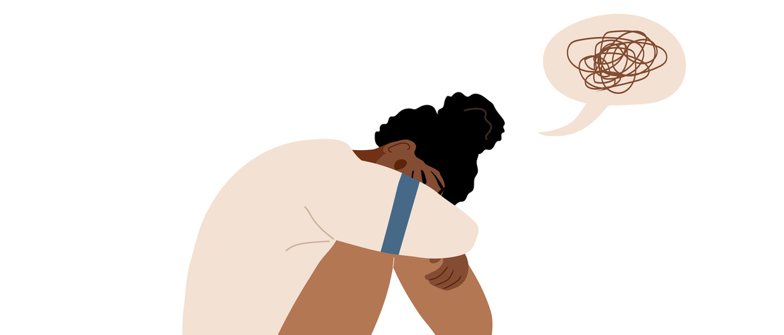
Major Depressive Disorder

Slide 16

Major Depressive Disorder
Major Depressive Disorder (also known as depression) is a common mood disorder. It involves a depressed mood or loss of pleasure or interest in activities for long periods of time (persistent).
People with Major Depressive Disorder experience low mood most of the day, nearly every day or loss of interest or pleasure in all or almost all activities for at least 2 weeks.

Slide 17
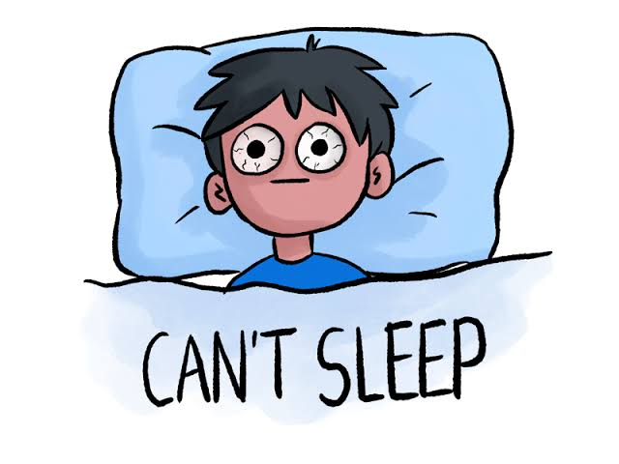
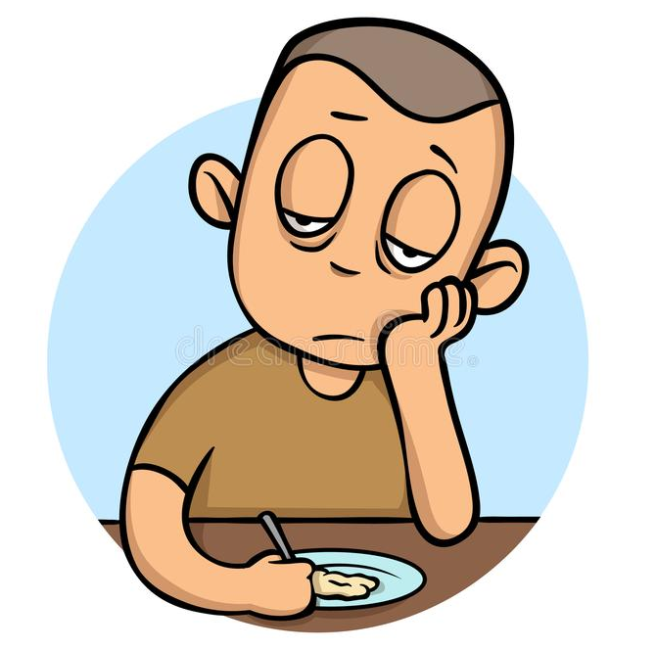
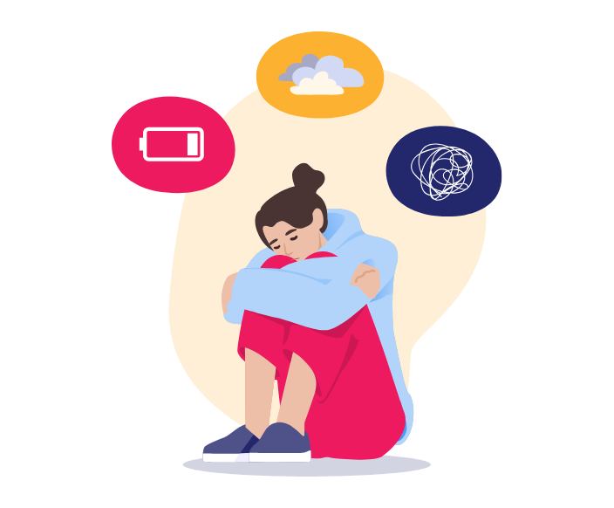
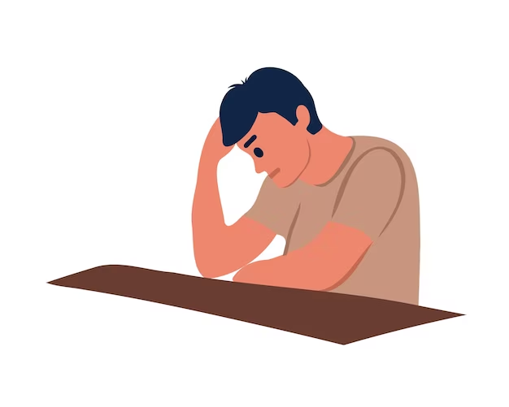
Sleep disturbance
Fatigue or loss of energy. Even small tasks take extra effort.
Feelings of excessive guilt or low self-worth
Hopelessness about the future
Significant weight loss/weight gain. Changes in appetite
Poor concentration or indecisiveness
Thoughts about dying or suicide
Clinically significant distress or impairment in social, occupational or other important areas of functioning.

Slide 18
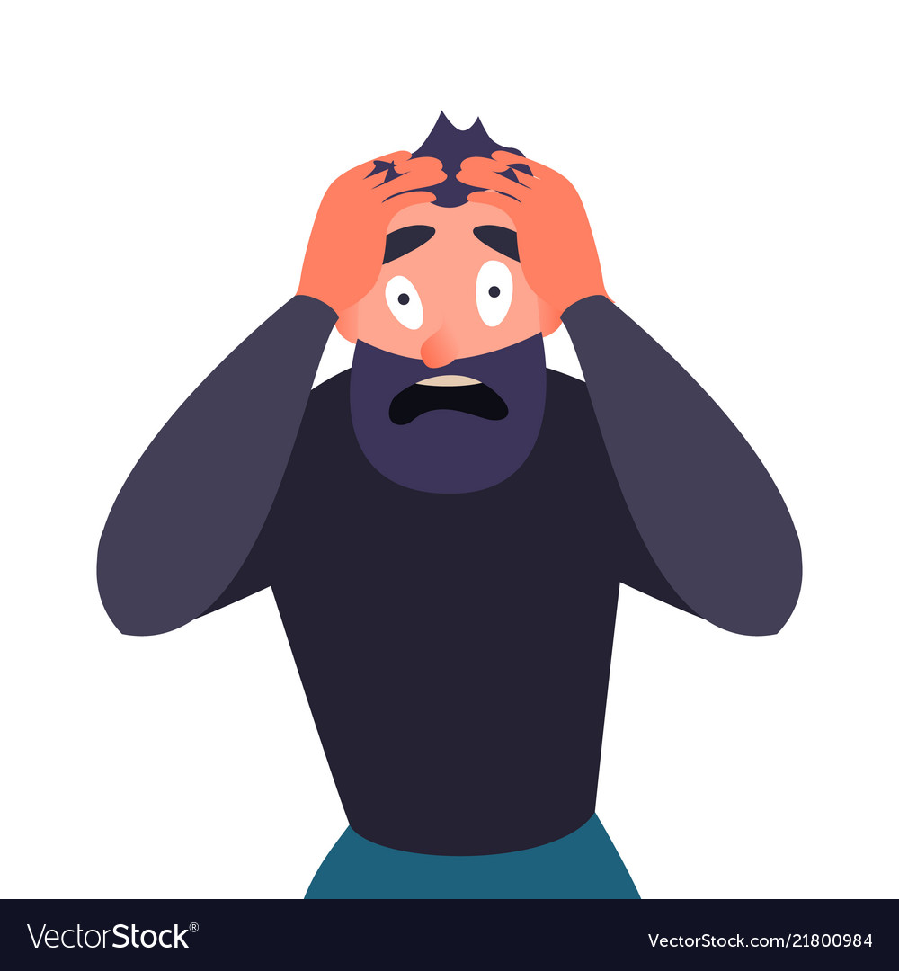
Panic Disorder

Slide 19
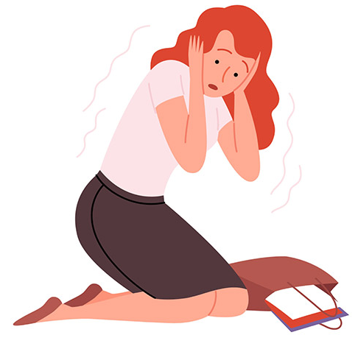
Panic Disorder
An anxiety disorder where you regularly have sudden attacks of panic or fear.
panic attacks (a sudden episode of intense fear) occur that last from a few seconds to several hours.
These frequent and unexpected panic attacks are characterized by a sudden wave of fear or discomfort or a sense of losing control even when there is no clear danger or trigger.

Slide 20
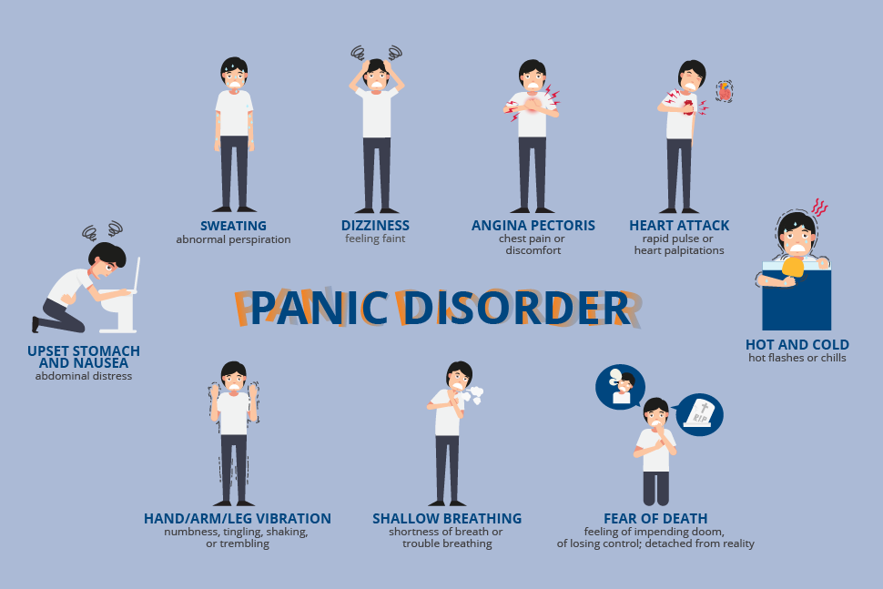

Slide 21
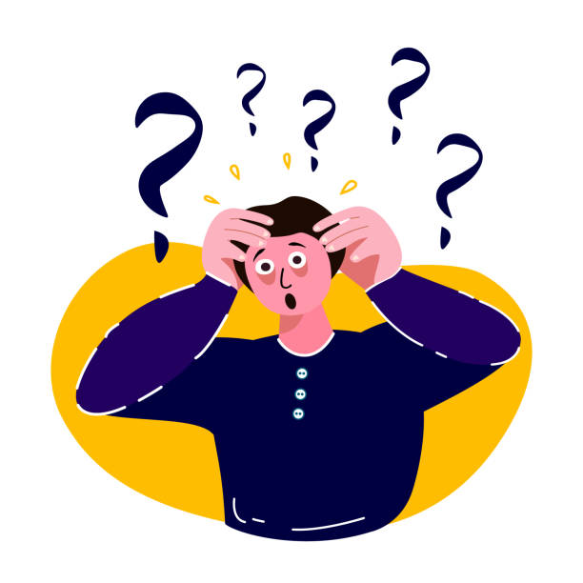
People with panic disorder may have:
Sudden and repeated panic attacks of overwhelming anxiety and fear.
Panic attacks often include physical symptoms that might feel like a heart attack, such as trembling, tingling, or rapid heart rate.
A fear or avoidance of places where panic attacks have occurred in the past.
An intense worry about when the next panic attack will happen. Many people with panic disorder worry about the possibility of having another attack and may significantly change their life to avoid having another attack. Panic attacks can occur at any time.
Unlike phobias, which are stimulated by specific objects or situations, panic disorders do not have any identifiable stimuli
People with panic disorder think that they’re losing control, having a heart attack or even dying. During an attack, anxiety rises to a peak, and an individual feels a sense of impending, unavoidable doom.
https://www.youtube.com/watch?v=5ksC0Yl348o

Slide 22
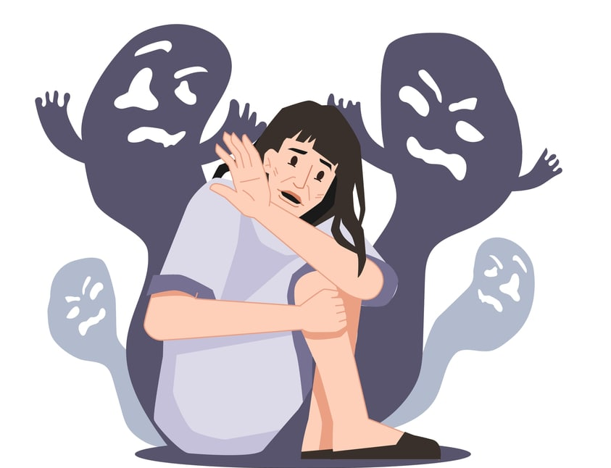
Schizophrenia

Slide 23
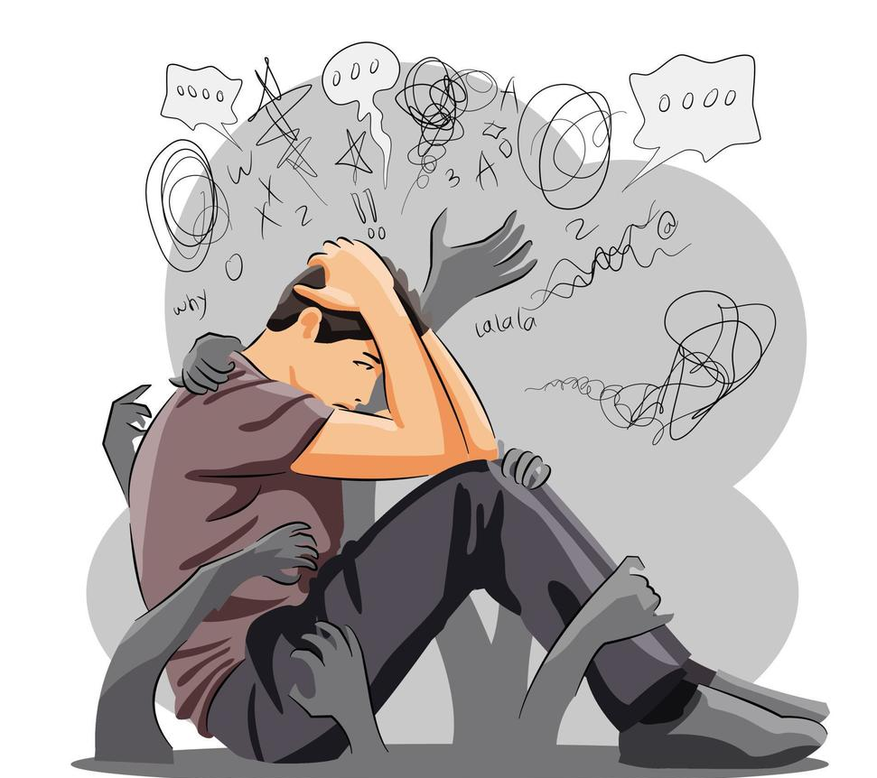
Schizophrenia
A serious mental illness that affects how a person thinks, feels, and behaves.
People with schizophrenia may seem like they have lost touch with reality, which can be distressing for them and for their family and friends. Severe distortion of reality occurs.
Schizophrenia may result in some combination of hallucinations, delusions, and extremely disordered thinking and behavior that impairs daily functioning, and can be disabling.
Thinking, perception, and emotion may deteriorate; the individual may withdraw from social interaction; and the person may display bizarre behavior.

Slide 24
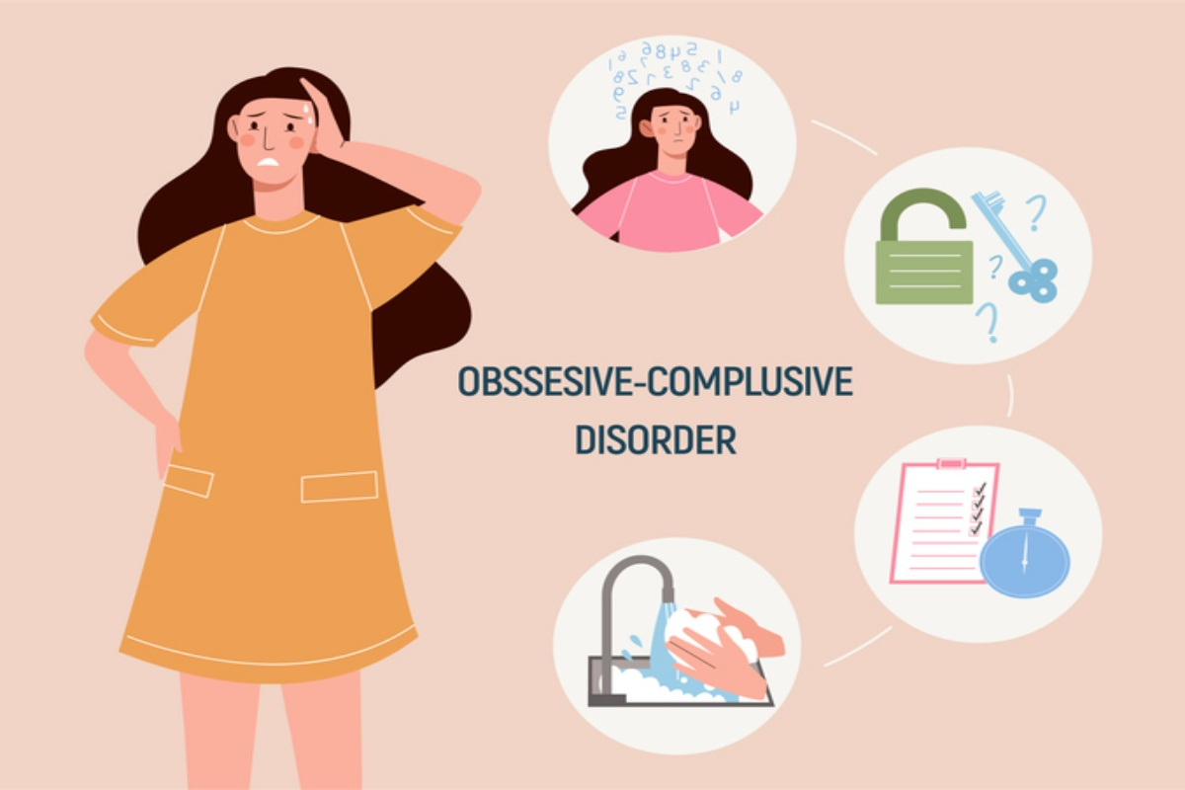

Slide 25
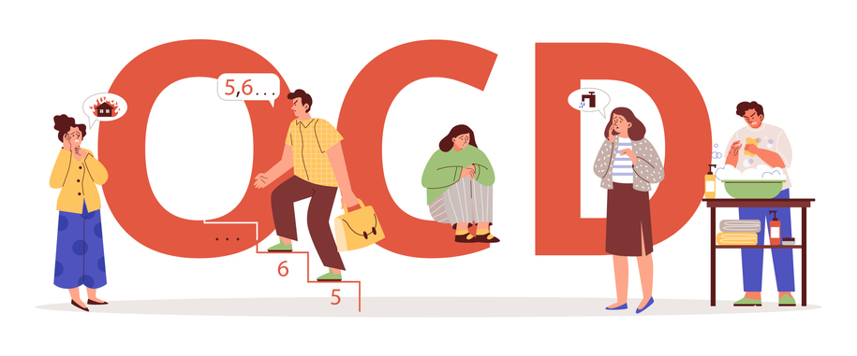
A disorder in which people have recurring, unwanted thoughts, ideas or sensations (obsessions). To get rid of the thoughts, they feel driven to do something repetitively (compulsions).
People may also experience compulsions, irresistible urges to repeatedly carry out some act that seems strange and unreasonable even to them.
Whatever the compulsive behavior is, people experience extreme anxiety if they cannot carry it out even if it is something they want to stop.
Examples: Repeatedly checking the stove if its turned off, excessive hand washing, counting, repeating words silently, or rituals.
An obsession is a persistent, unwanted thought, idea or image that keeps recurring.

Slide 26
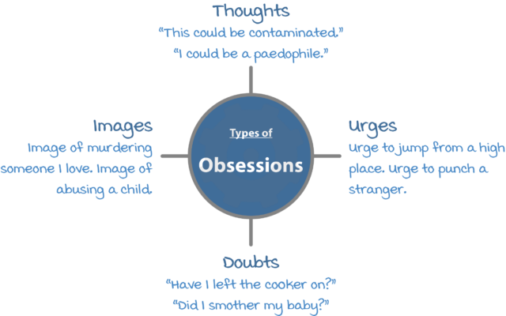
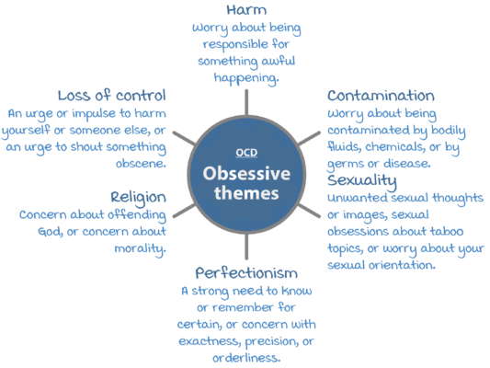

Slide 27
Monica’s fear that she would harm her baby
Shortly after my first baby was born, I started worrying that I would harm her. I would have unwanted thoughts and images of smothering or suffocating my baby, and whenever I was in a high place, I would have unwanted thoughts like “what if I threw her off?”. It was horrifying – I thought this meant I was a terrible mother and couldn’t be trusted to be alone with my baby. I tried to push these thoughts away as much as I could. To keep the baby safe, I insisted that my husband be responsible for most of her care. If I couldn’t avoid looking after her, I would pray in my mind the whole time that nothing bad would happen. I didn’t tell anyone about these thoughts in case she was taken away from me.

Slide 28
The repetitive behaviors, such as hand washing/cleaning, checking on things, mental acts (like counting), or other activities, can significantly interfere with a person’s daily activities and social interactions.
Many people without OCD have distressing thoughts or repetitive behaviors. However, these do not typically disrupt daily life.
For people with OCD, thoughts are persistent and intrusive, and behaviors are rigid.
Many people with OCD know or suspect their obsessional thoughts are not realistic; others may think they could be true. Even if they know their obsessional thoughts are not realistic, people with OCD have difficulty disengaging from the obsessive thoughts or stopping the compulsive actions.

Slide 29
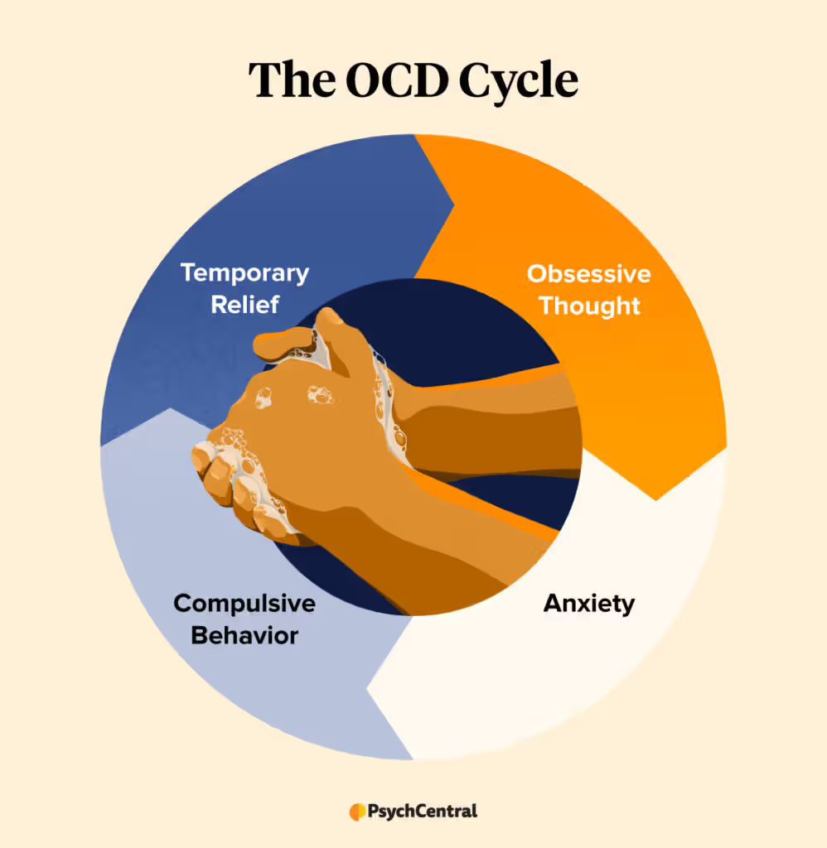
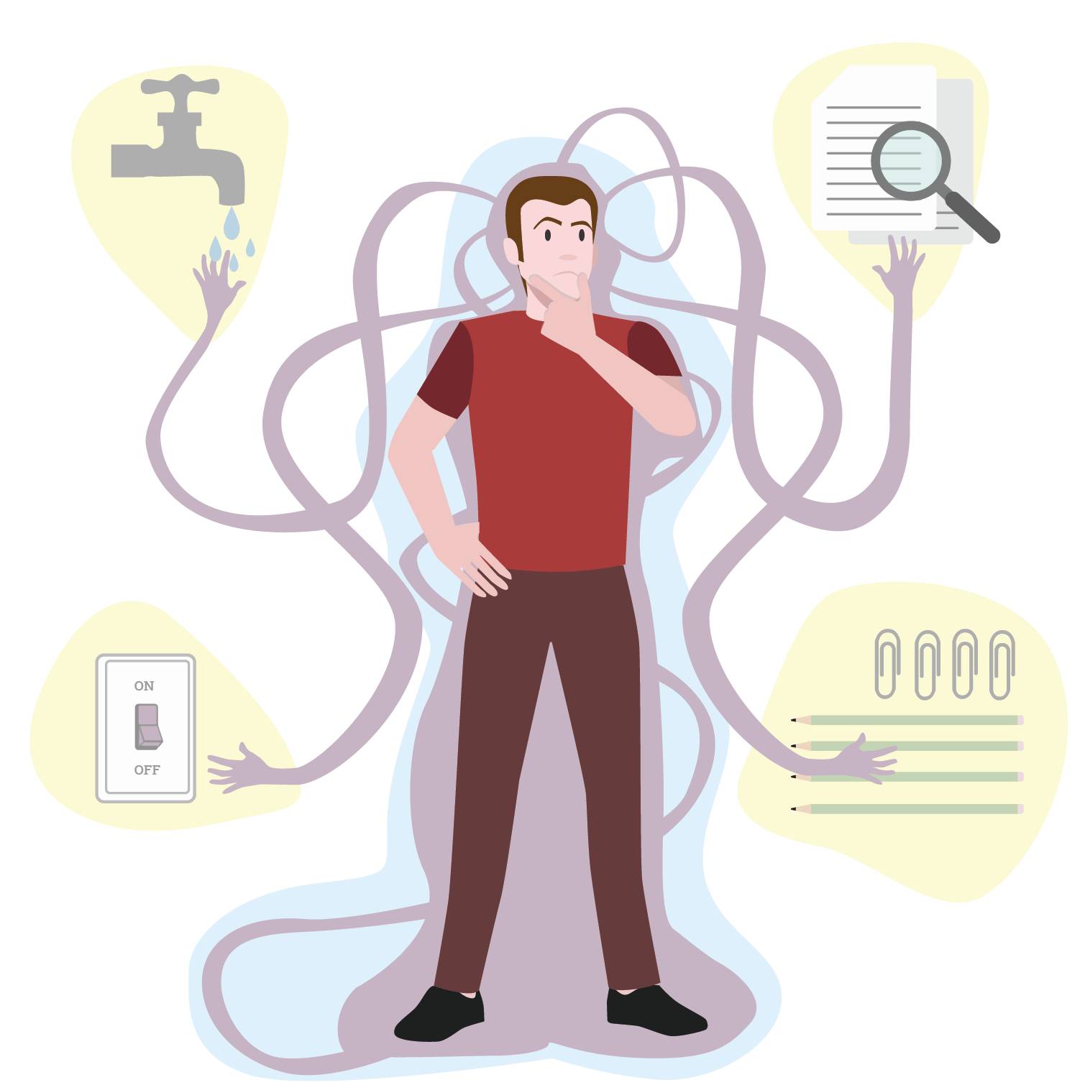

Slide 30
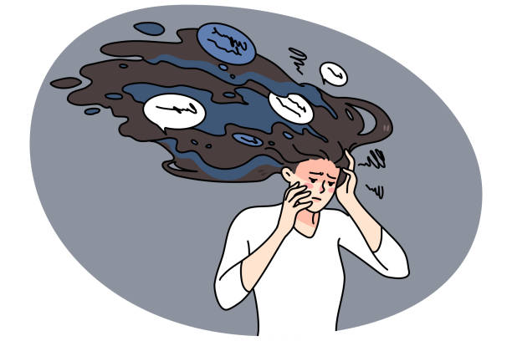
Post-Traumatic Stress Disorder (PTSD)

Slide 31
Post-Traumatic Stress Disorder (PTSD)
A disorder that develops in some people who have experienced a shocking, scary, or dangerous event.
Directly experience, witness traumatic events or learn that something bad happened with family member or loved one
Irritability or anger outburst
Poor concentration
Sleep disturbance
hypervigilance
Experience recurrent, involuntary distressing memories or dreams or flashbacks of traumatic event
Persistence avoidance of stimulus associated with traumatic event

Slide 32
Posttraumatic Stress Disorder (PTSD) is a psychiatric disorder that can occur in people who have experienced or witnessed a traumatic event, series of events or set of circumstances.
Examples include natural disasters, serious accidents, terrorist acts, war/combat, rape/sexual assault, historical trauma, intimate partner violence and bullying.
A diagnosis of PTSD requires exposure to an upsetting traumatic event. Exposure includes directly experiencing an event, witnessing a traumatic event happening to others, or learning that a traumatic event happened to a close family member or friend. It can also occur as a result of repeated exposure to horrible details of trauma such as police officers exposed to details of child abuse cases.

Slide 33
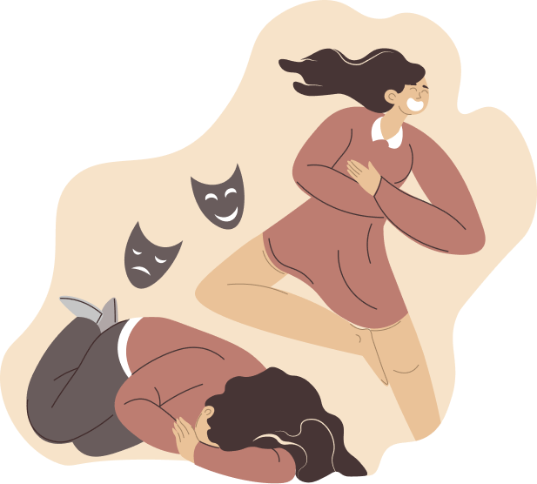
Bipolar Disorder

Slide 34
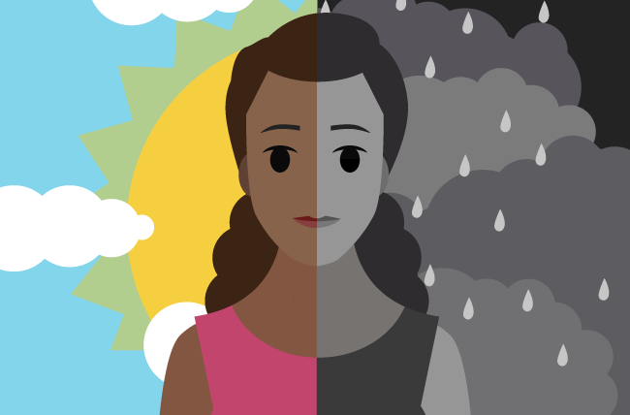
Bipolar Disorder
A group of mood disorders that cause extreme fluctuation in a person’s mood, energy, and ability to function.
People who live with bipolar disorder experience periods of great excitement, over activity, delusions, and euphoria (known as mania) and other periods of feeling sad and hopeless (known as depression).
Emotional highs (mania or hypomania) and lows (depression).
These mood swings can affect sleep, energy, activity, judgment, behavior and the ability to think clearly.

Slide 35
People with bipolar disorder experience intense emotional states that typically occur during distinct periods of days to weeks, called mood episodes.
These mood episodes are categorized as manic/hypomanic (abnormally happy or irritable mood) or depressive (sad mood).
People without bipolar disorder experience mood fluctuations as well. However, these mood changes typically last hours rather than days. Also, these changes are not usually accompanied by the extreme degree of behavior change or difficulty with daily routines and social interactions that people with bipolar disorder demonstrate during mood episodes. Bipolar disorder can disrupt a person’s relationships with loved ones and cause difficulty in working or going to school.

Slide 36
Internet Gaming Disorder
Internet Gaming
Online games are very popular, at least one person plays video games in two-thirds of American households, according to the Entertainment Software Association. Roughly 160 million American adults play internet-based games, one recent study estimates. The games can be very entertaining, and it may be easy to get absorbed in the competition, but can they be addictive? That is a question still being debated among researchers and health professionals, but early evidence suggests that videogames are one of the most addicting technologies around. In fact, new research shows that there are plenty of safe and effective treatments for videogame addiction already in use.
Internet Gaming in DSM-5

Slide 37
Addiction to gaming is described in the American Psychiatric Association's Diagnostic and Statistical Manual of Mental Disorders (DSM-5-TR), which is used by mental health professionals to diagnose mental disorders. In the DSM-5-TR, the condition is referred to as Internet Gaming Disorder (IGD)(1). IGD is included in the section recommending conditions for further research, along with caffeine use disorder and other conditions.
The DSM-5-TR includes substance-related addictive disorders, such as alcohol, tobacco, stimulants, marijuana and opioids. Gambling disorder is the only behavioral addiction (as opposed to chemical substance use disorders) identified in DSM-5-TR.
If you are concerned for yourself or a loved one about preoccupation with gaming and related problems, contact your health care provider or a mental health professional.The DSM-5-TR notes that IGD must cause "significant impairment or distress" in several aspects of a person's life. This proposed condition is limited to gaming and does not include problems with general use of the internet, online gambling, or use of social media or smartphones. The proposed symptoms of internet gaming disorder include:

Slide 38
Preoccupation with gaming
Withdrawal symptoms when gaming is taken away or not possible (sadness, anxiety, irritability)
Tolerance, the need to spend more time gaming to satisfy the urge
Inability to reduce playing, unsuccessful attempts to quit gaming
Giving up other activities, loss of interest in previously enjoyed activities due to gaming
Continuing to game despite problems
Deceiving family members or others about the amount of time spent on gaming
The use of gaming to relieve negative moods, such as guilt or hopelessness
Risk, having jeopardized or lost a job or relationship due to gaming

Slide 39

Treatment of Psychological Disorders
Treatment depends on the type of mental illness its severity and what works best.
In many cases, a combination of treatments works best.

Slide 40
Treatments
1. The psychological approach to reducing disorder involves providing help to individuals or families through psychological therapy, including psychoanalysis, humanistic-oriented therapy, cognitive behavioral therapy (CBT), and other approaches.
2. The biomedical approach to reducing disorder is based on the use of medications to treat mental disorders such as schizophrenia, depression, and anxiety, as well as the employment of brain intervention techniques, including electroconvulsive therapy (ECT), transcranial magnetic stimulation (TMS), and psychosurgery.

Slide 41

3. The social approach to reducing disorder focuses on changing the social environment in which individuals live to reduce the underlying causes of disorder.
These approaches include group, couple, and family therapy, as well as community outreach programs.
The community approach is likely to be the most effective of the three approaches because it focuses not only on treatment, but also on prevention of disorders (World Health Organization, 2004).

Slide 42
THANKS!

Slide 43
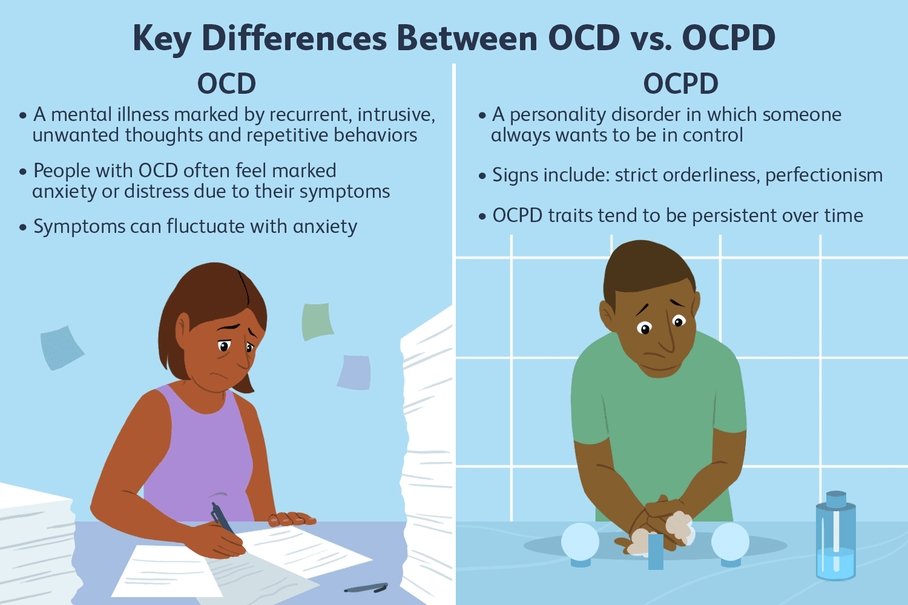

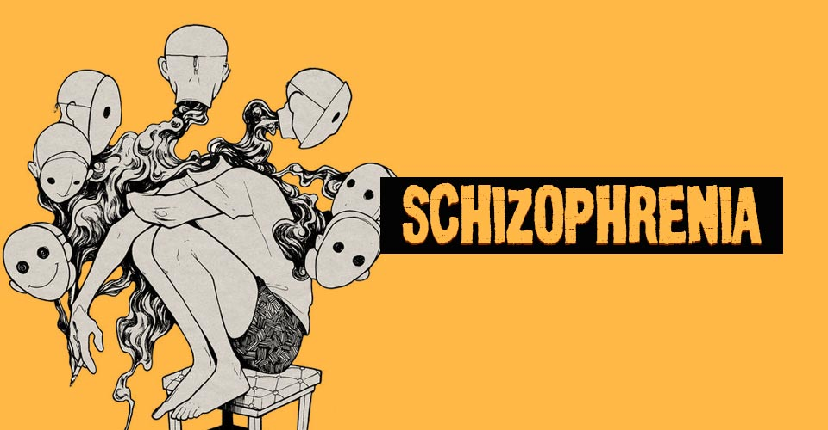
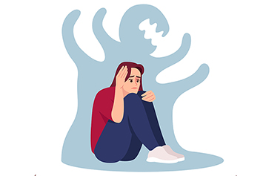
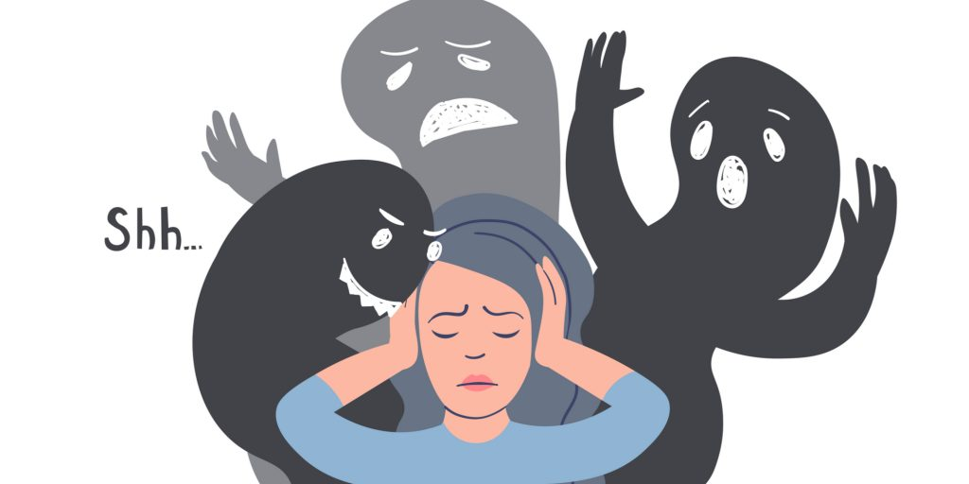
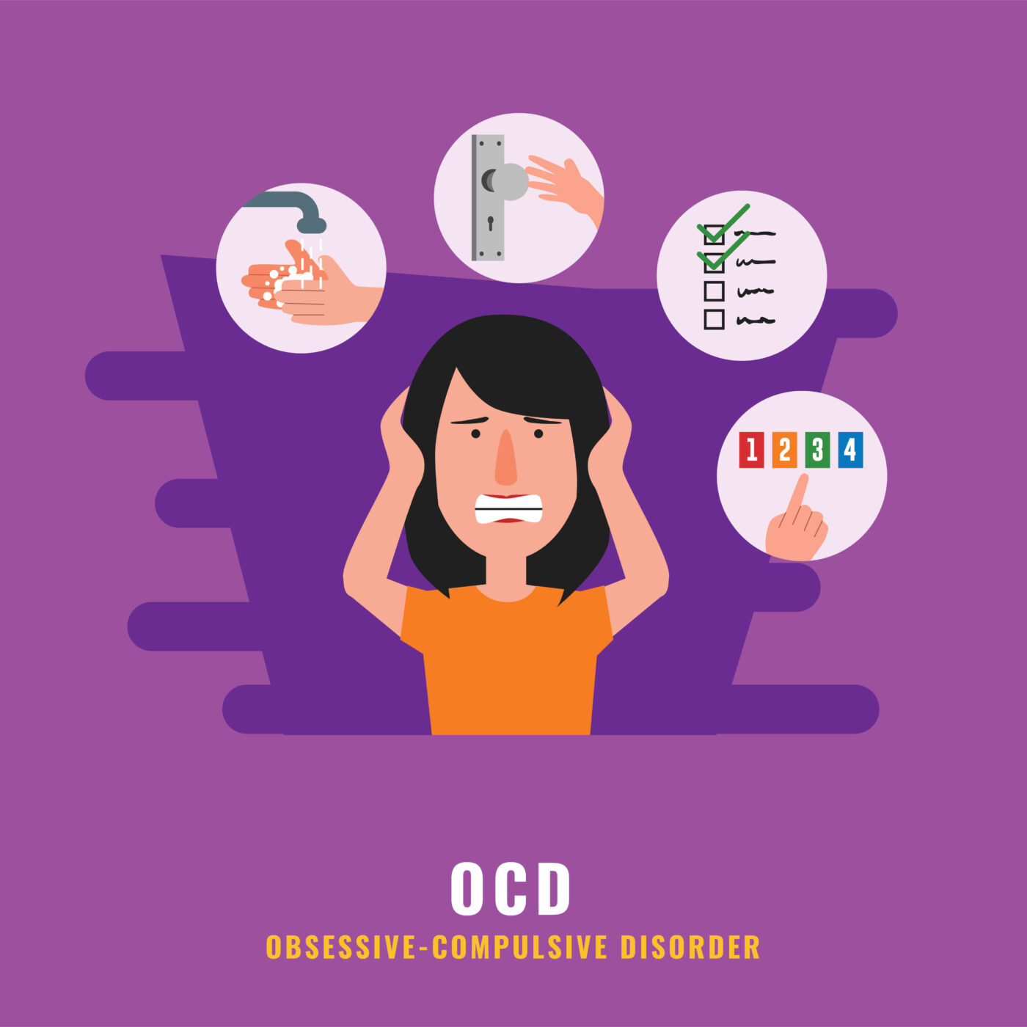

Slide 44
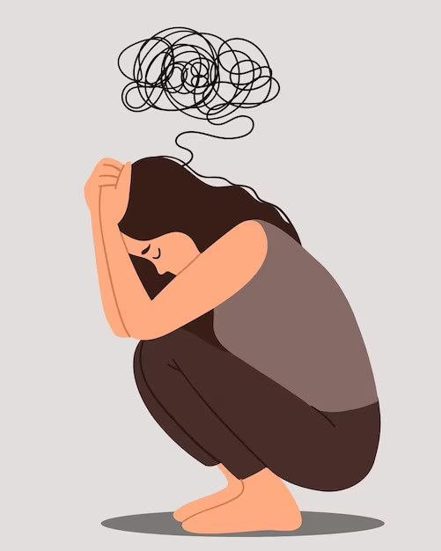
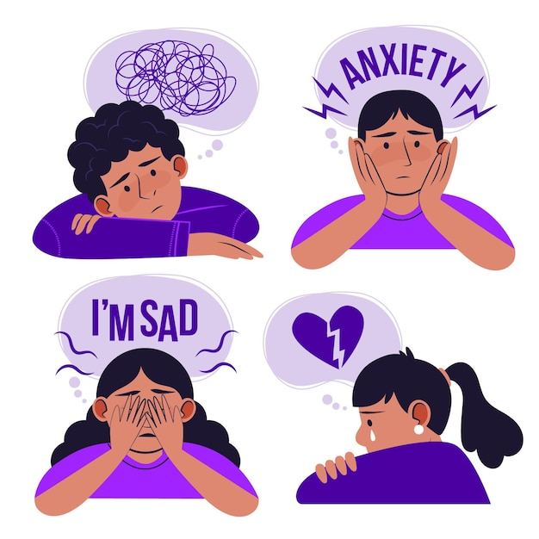
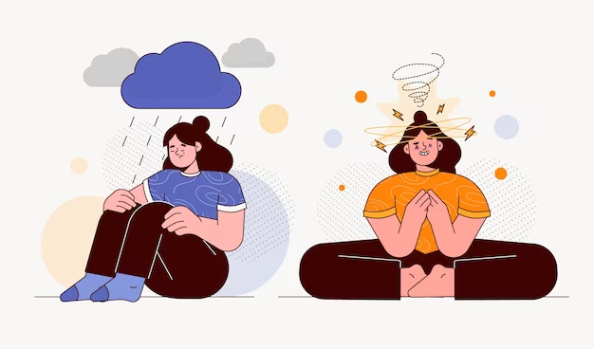

Slide 45
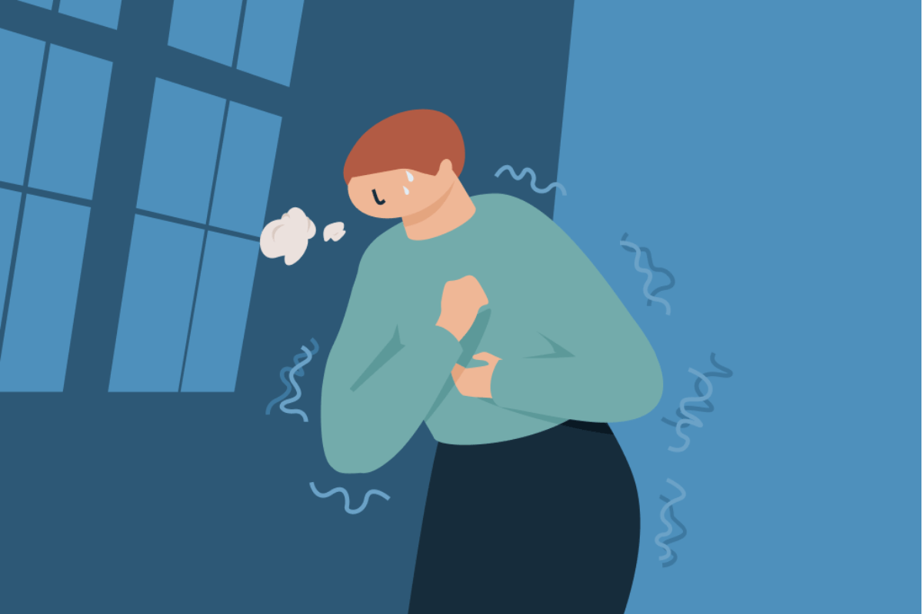
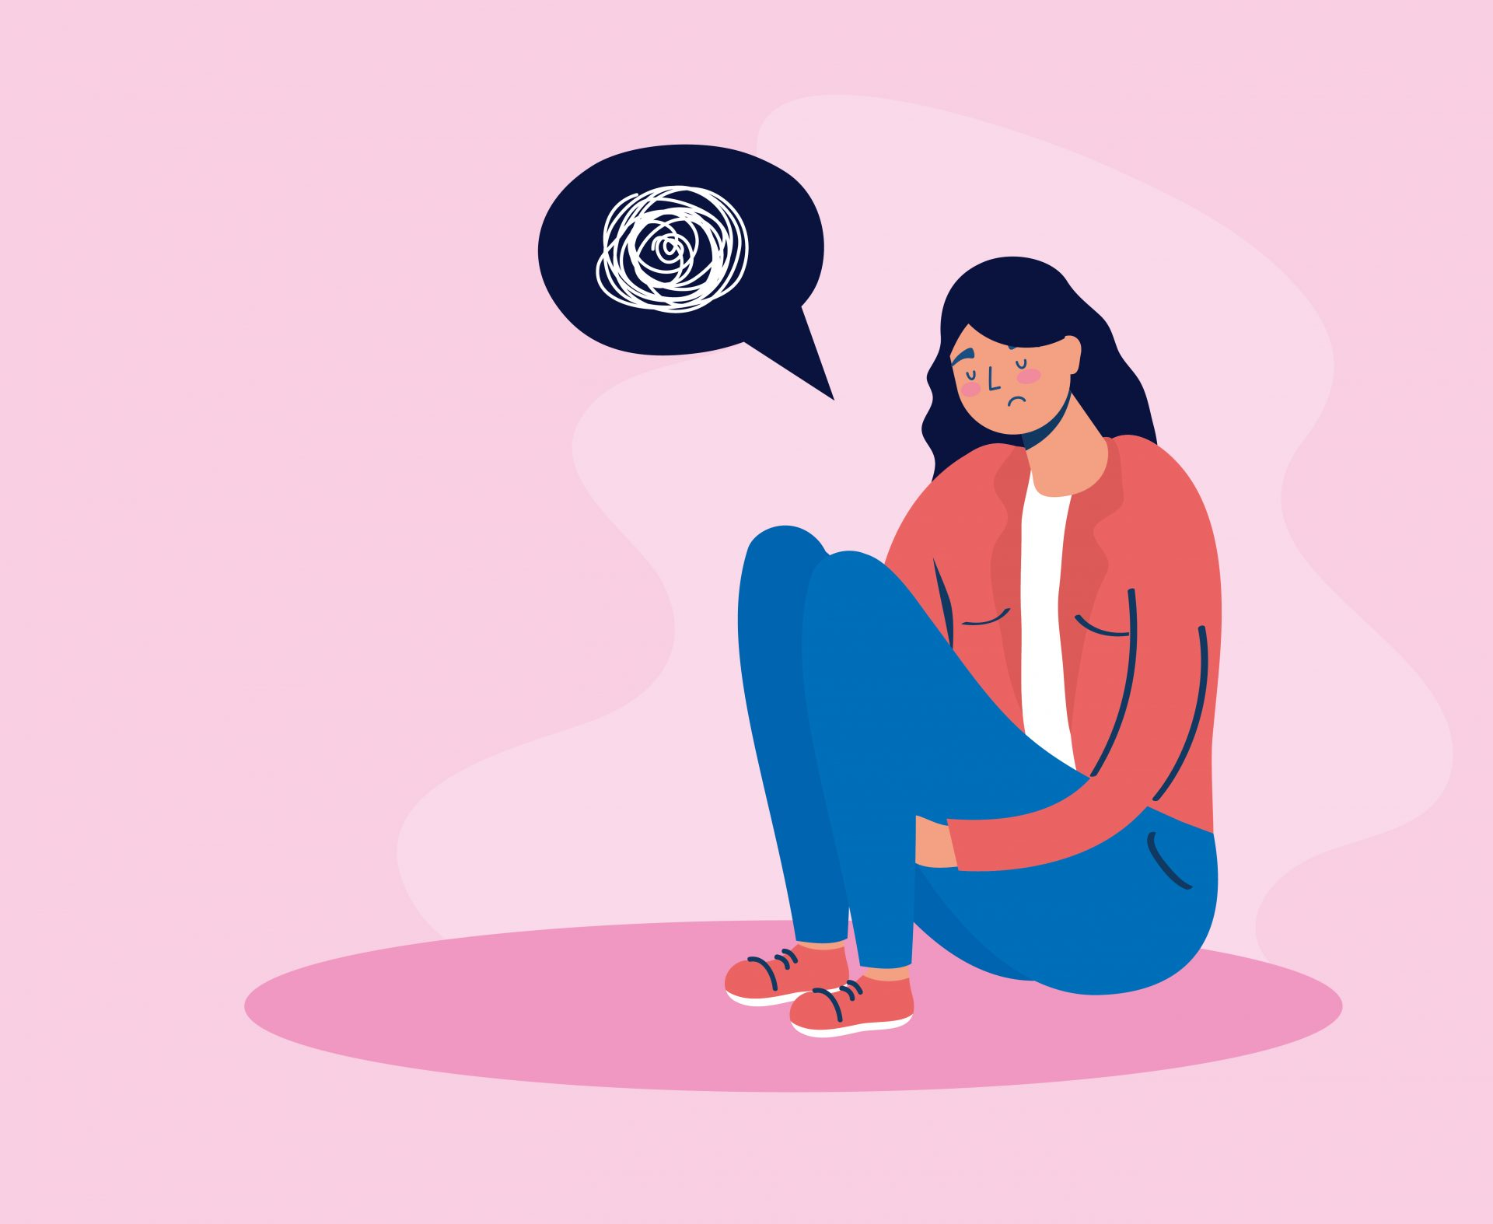
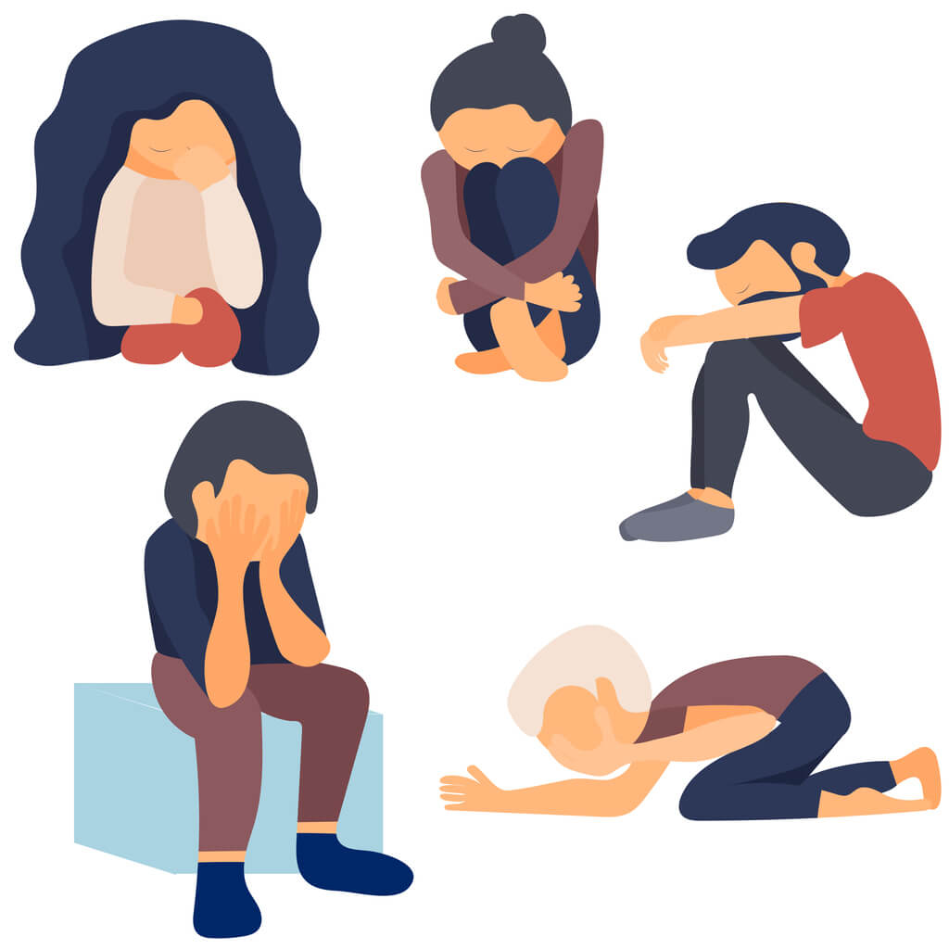
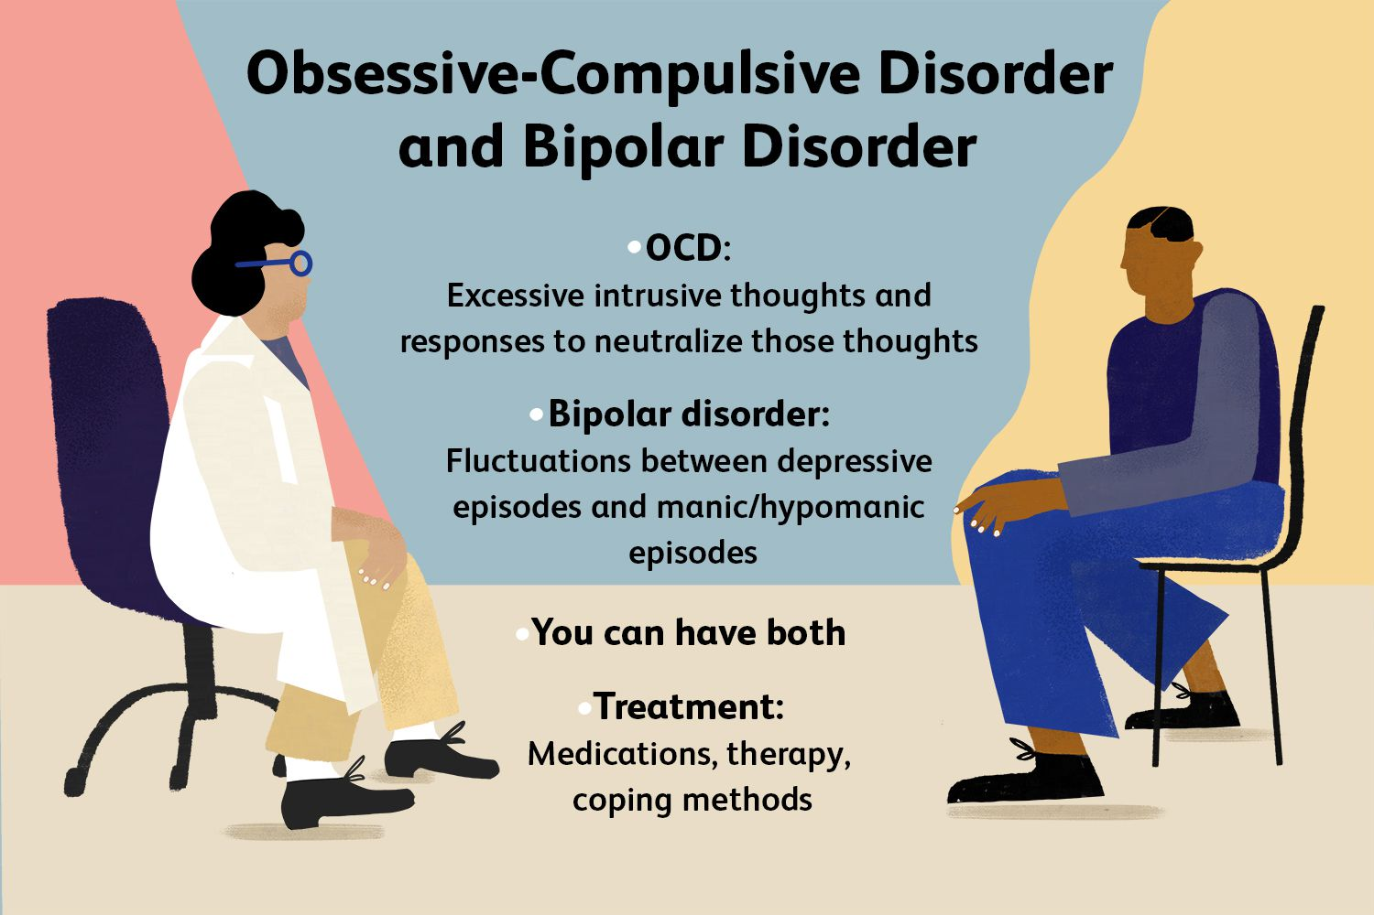

Slide 46
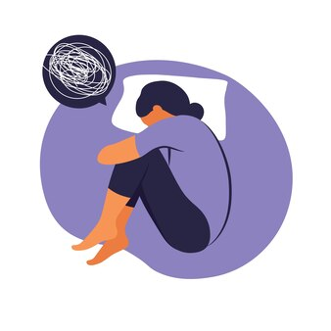
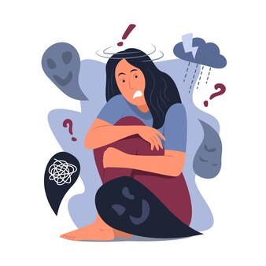
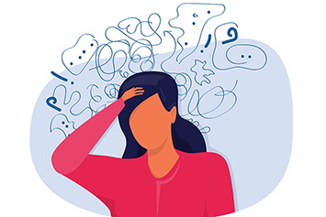
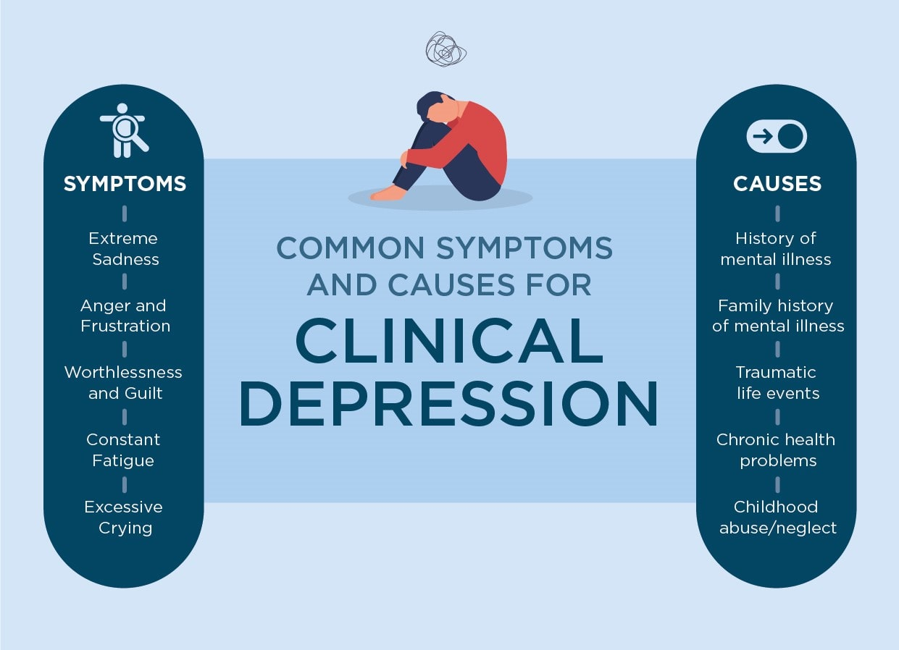
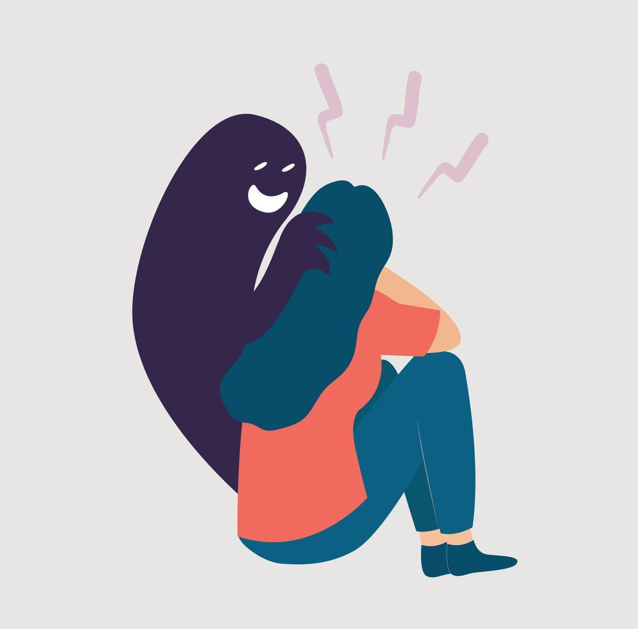
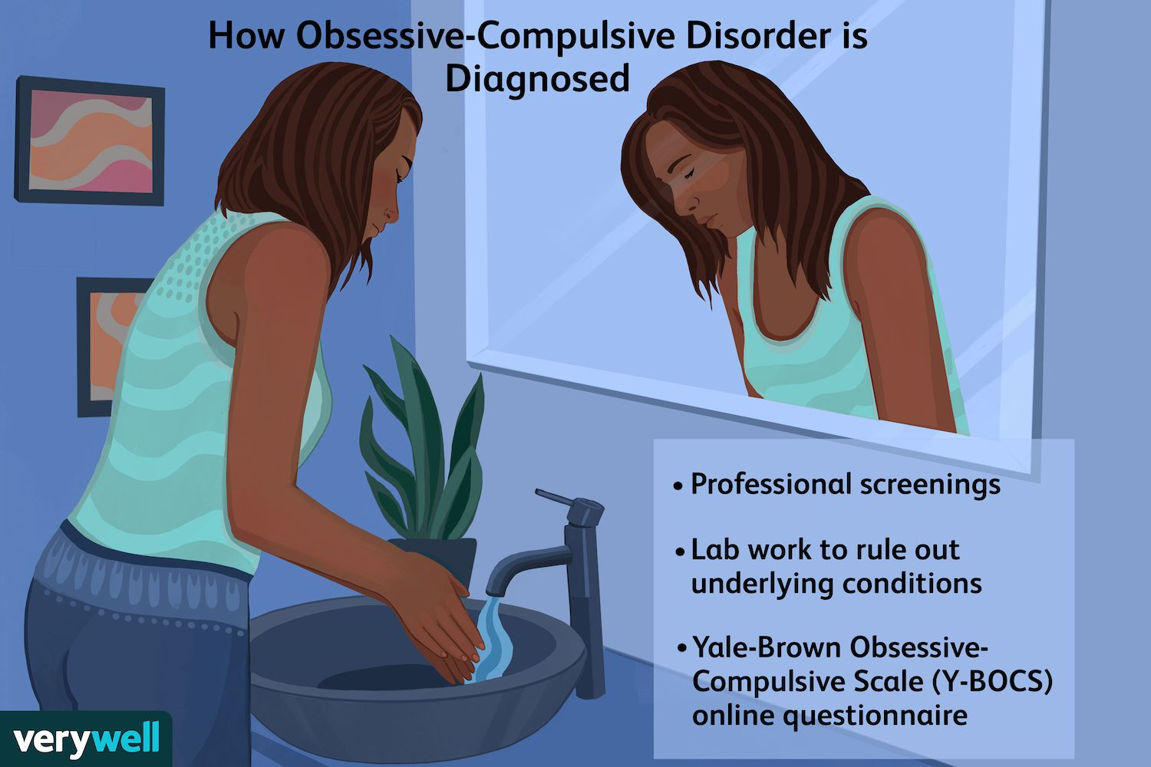
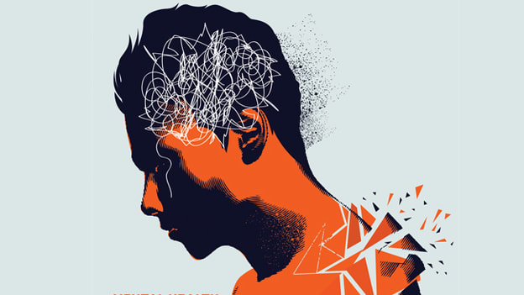
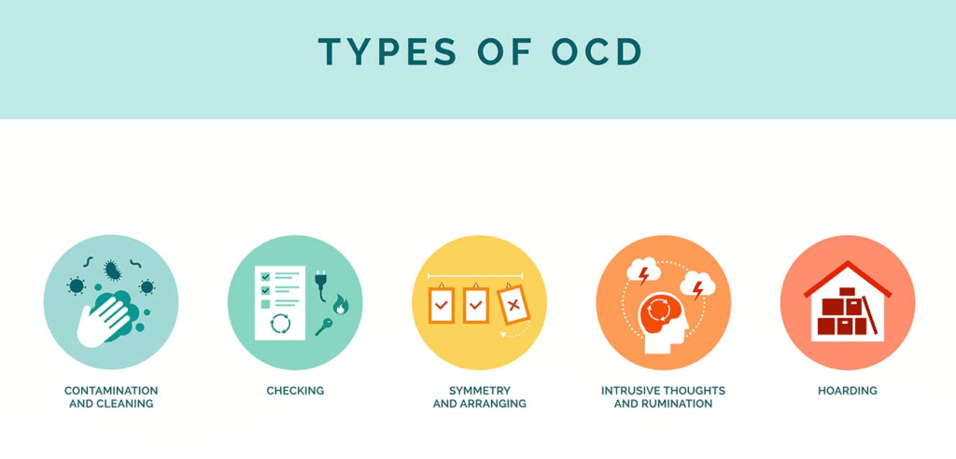

Slide 47
